Slide 1
Exploiting WebSocket Vulnerabilities
Understanding and Manipulating WebSockets

Slide 2





The Team
Davide Cirimele 247438
Martina Suriano 252313
Gabriele Tassone 252153
Giovambattista Crudo (GB) 252133
Alessio Maresca 256622

Slide 3
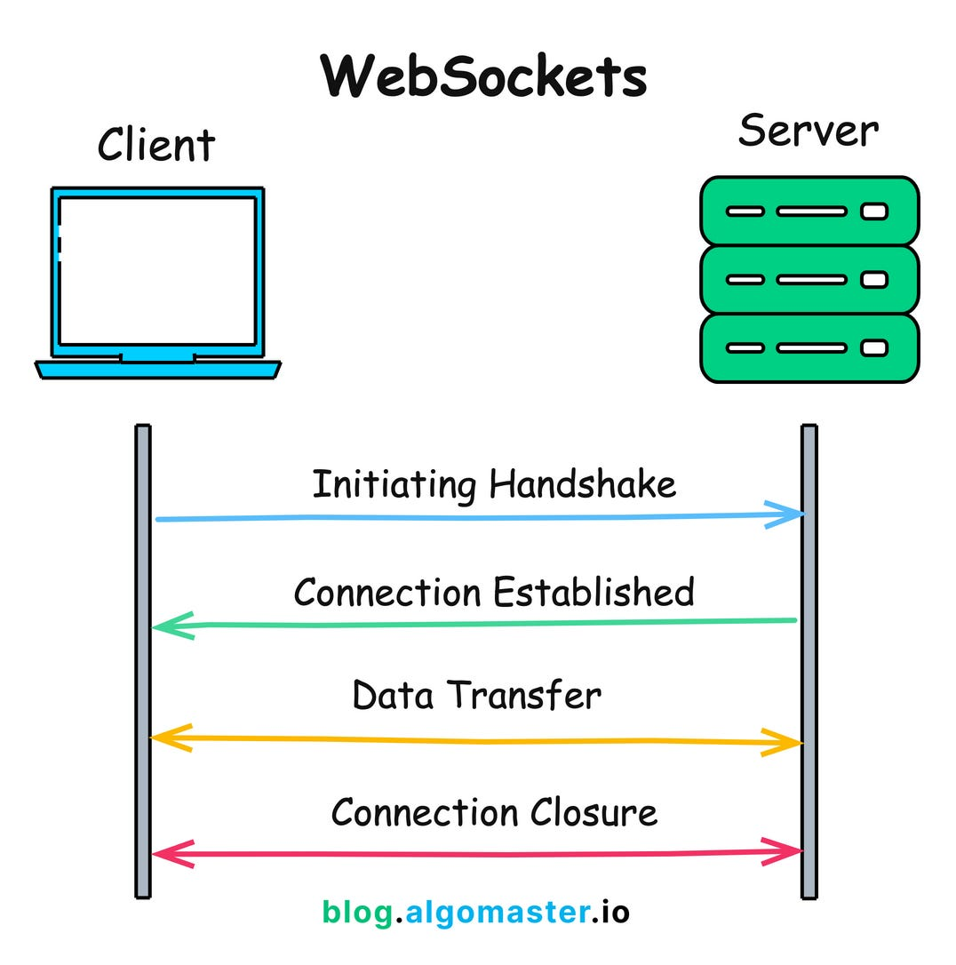
What is a WebSocket?
WebSockets are bi-directional, full duplex communications protocol over HTTP or HTTPS, useful for streaming data or asynchronous traffic helping in constructing low-latency and server-initiated conversations.

Slide 4
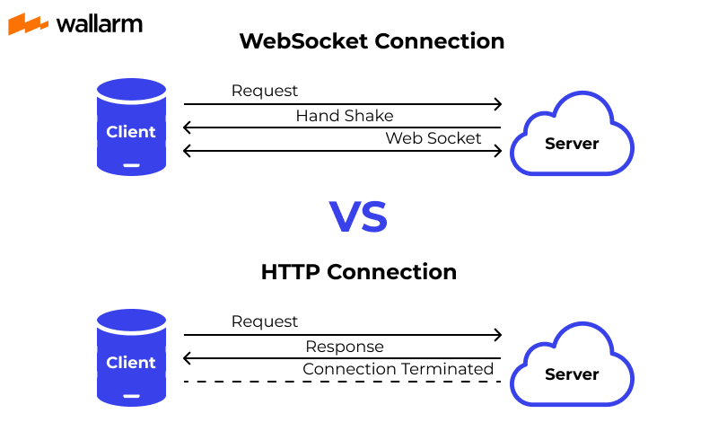
Why not HTTP?
HTTP is a powerful and a way more versatile mechanism, but it is still request/response based, whilst there are some scenarios in which we need to have a continuous connection in order to avoid polling/long polling.
This scenarios are usually:
Push Notification
Group Chats
Streaming

Slide 5
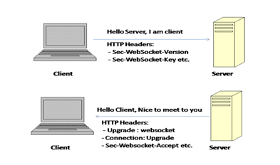
WebSocket Handshake
Initiated over HTTP and establishes a long-lived connection. Involves client sending a handshake request and server responding to upgrade the connection. Connection remains active for message exchanges.

Slide 6
WebSockets Security
The main difference between ws and wss is that one is build over http, and the other one over https, which helps us in understanding that websockets are just a technology, that is not secure by itself. WS need to be made secure with proper setup.

Slide 7
Common WebSocket… Vulnerabilities?
WebSockets enlarge the attack surface of an already unsafe application, making it easier for attackers to inject malicious payloads. Common flaws in WebSocket implementation are:
Unvalidated messages over the socket
Misplaced trust in HTTP headers. Session handling mechanisms. DDoS Attack

Slide 8
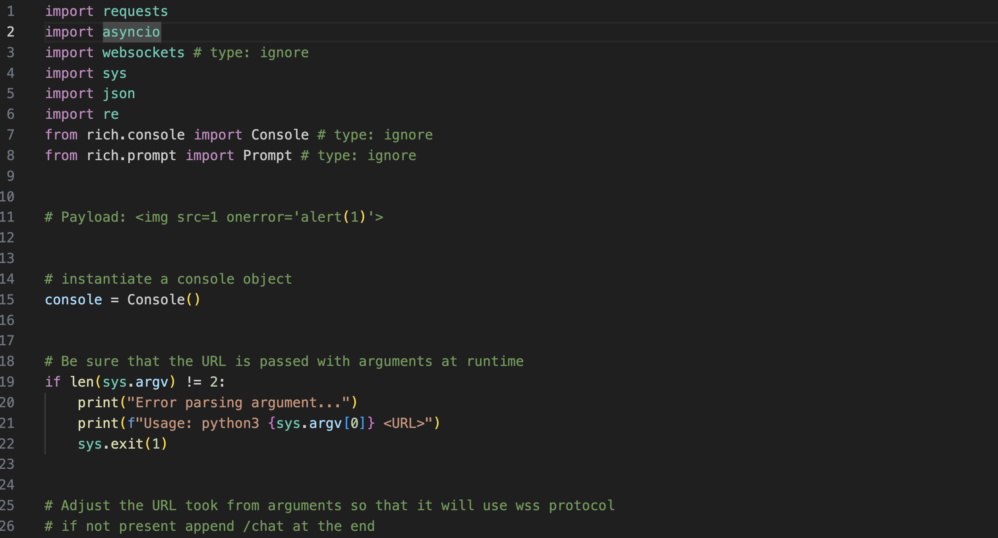

Slide 9
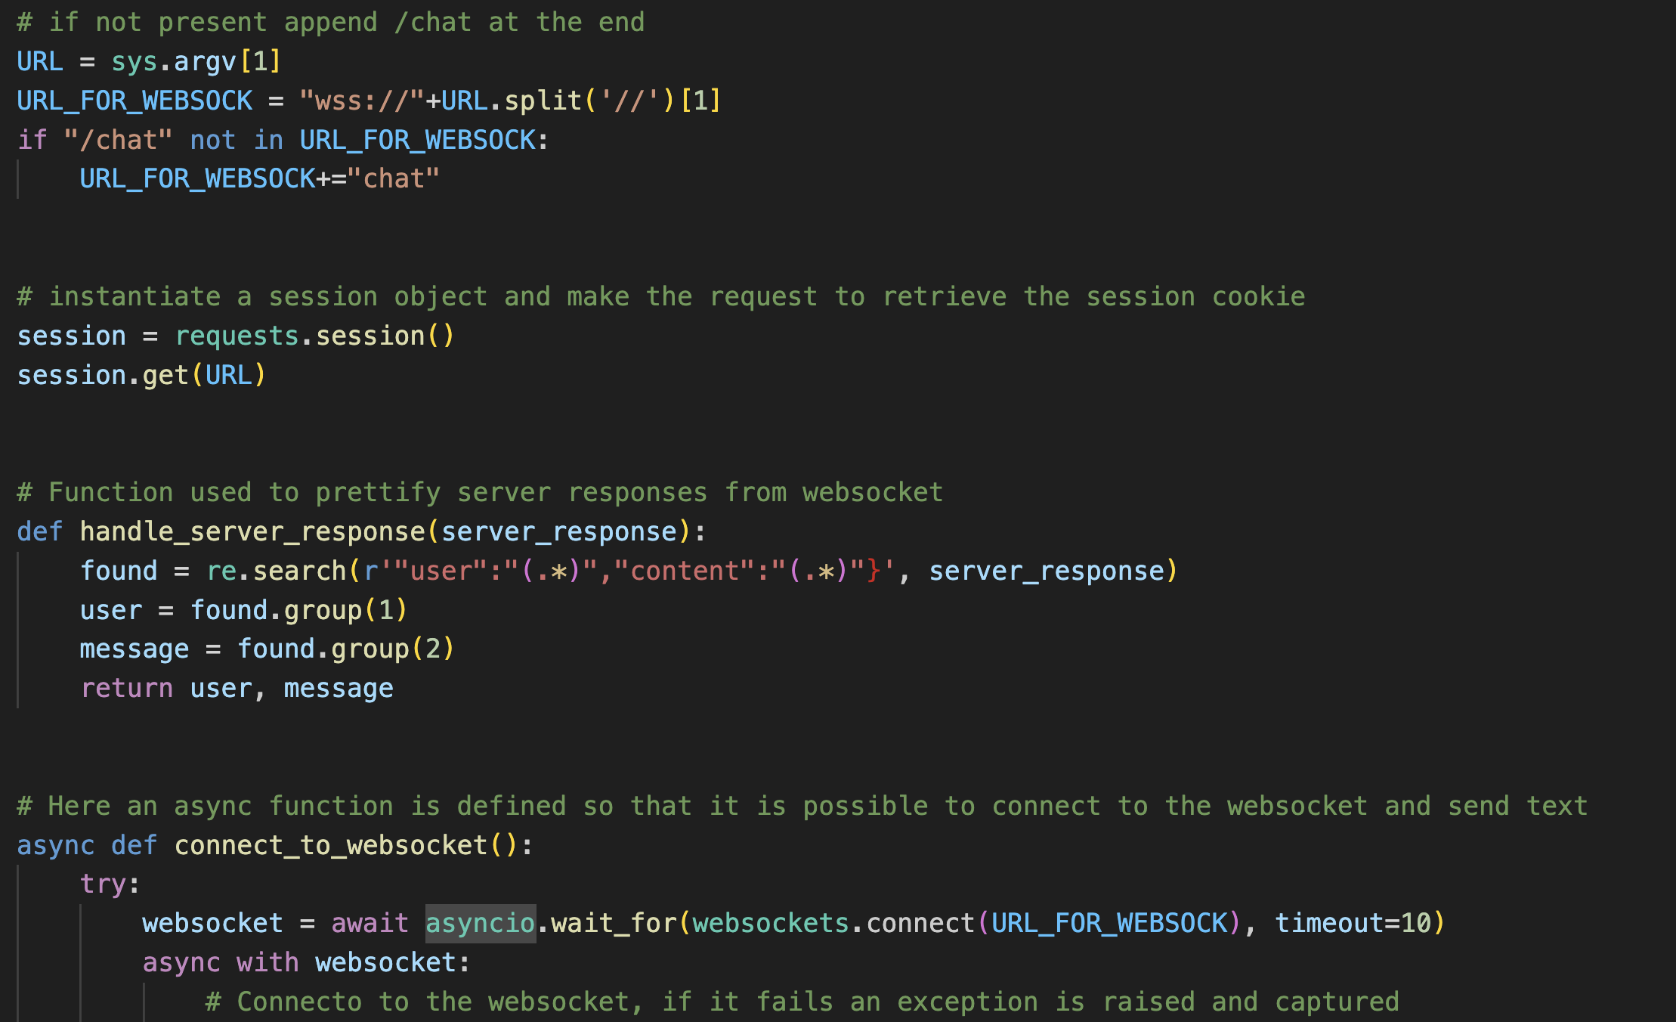

Slide 10
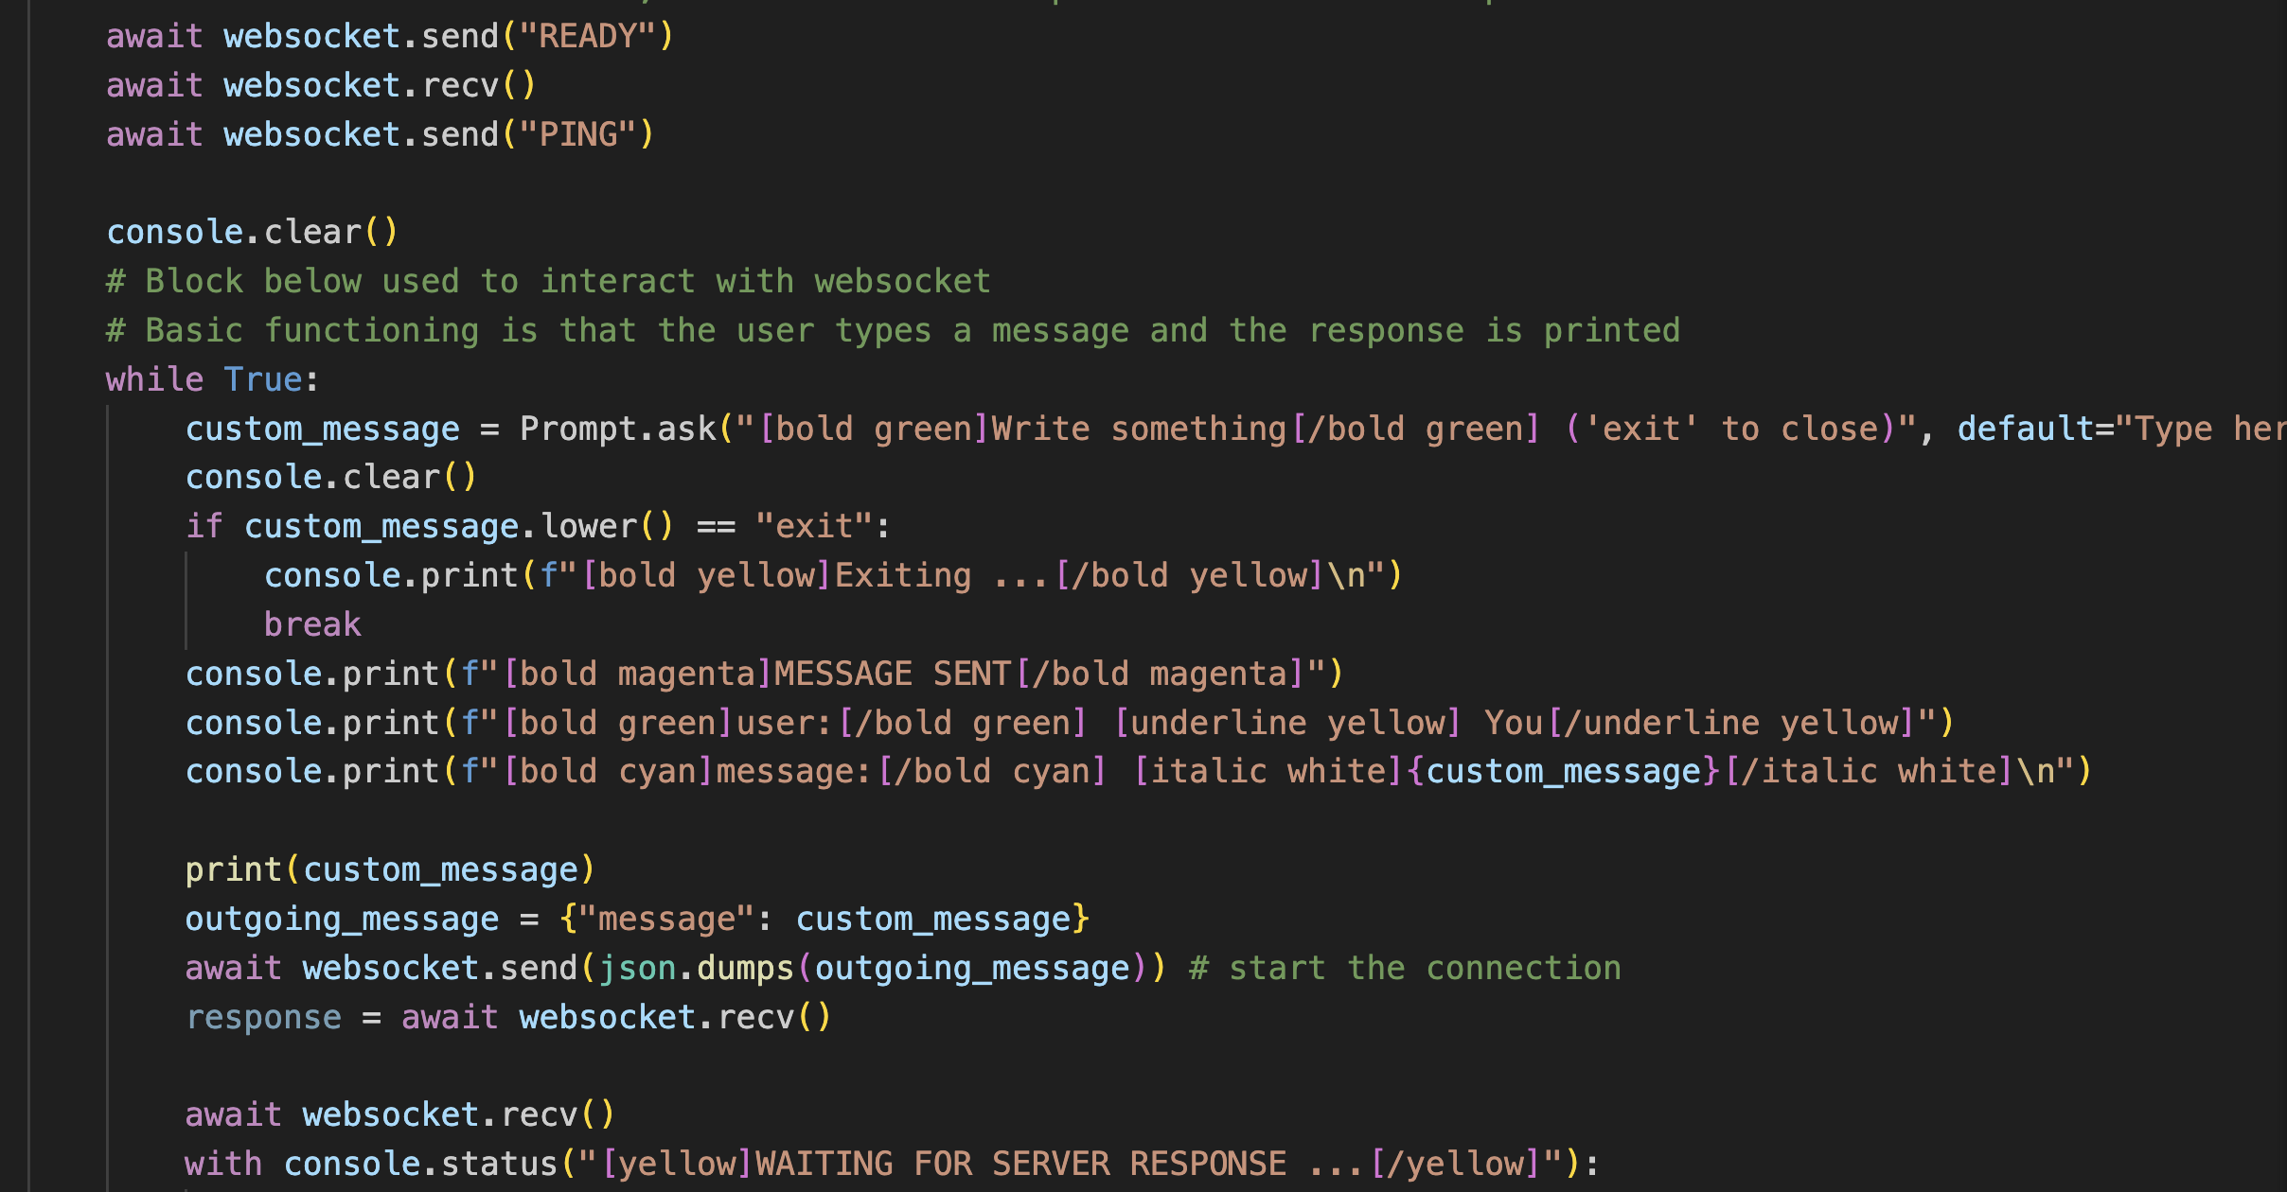

Slide 11
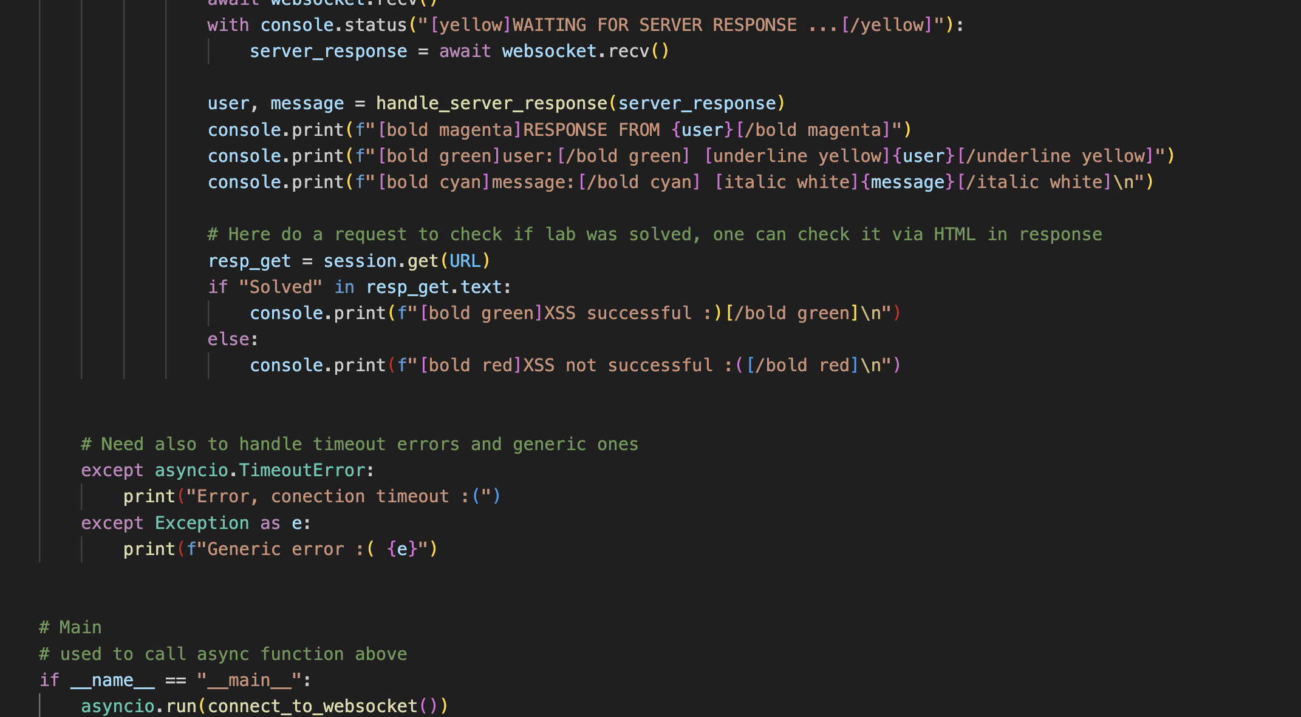

Slide 12
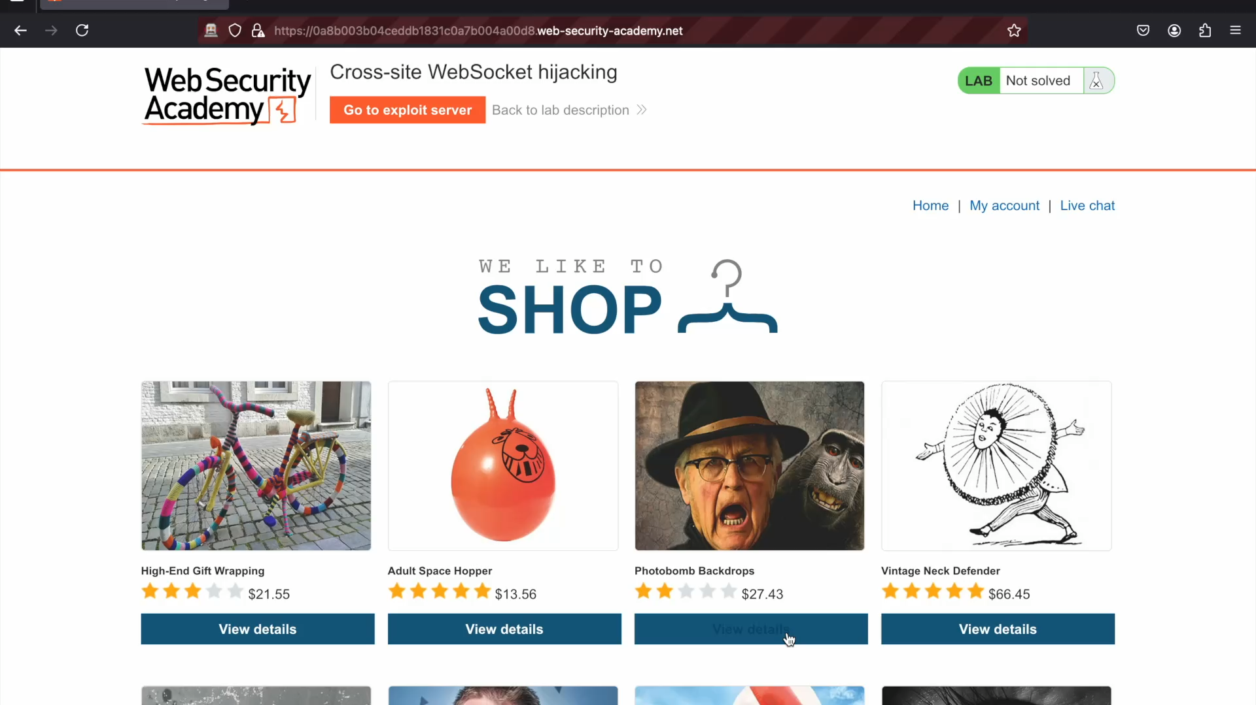

Slide 13
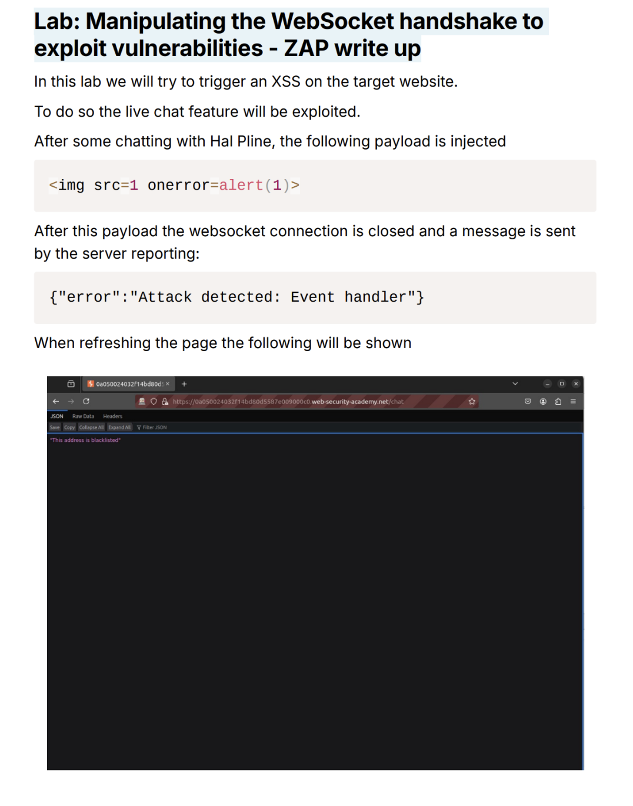

Slide 14
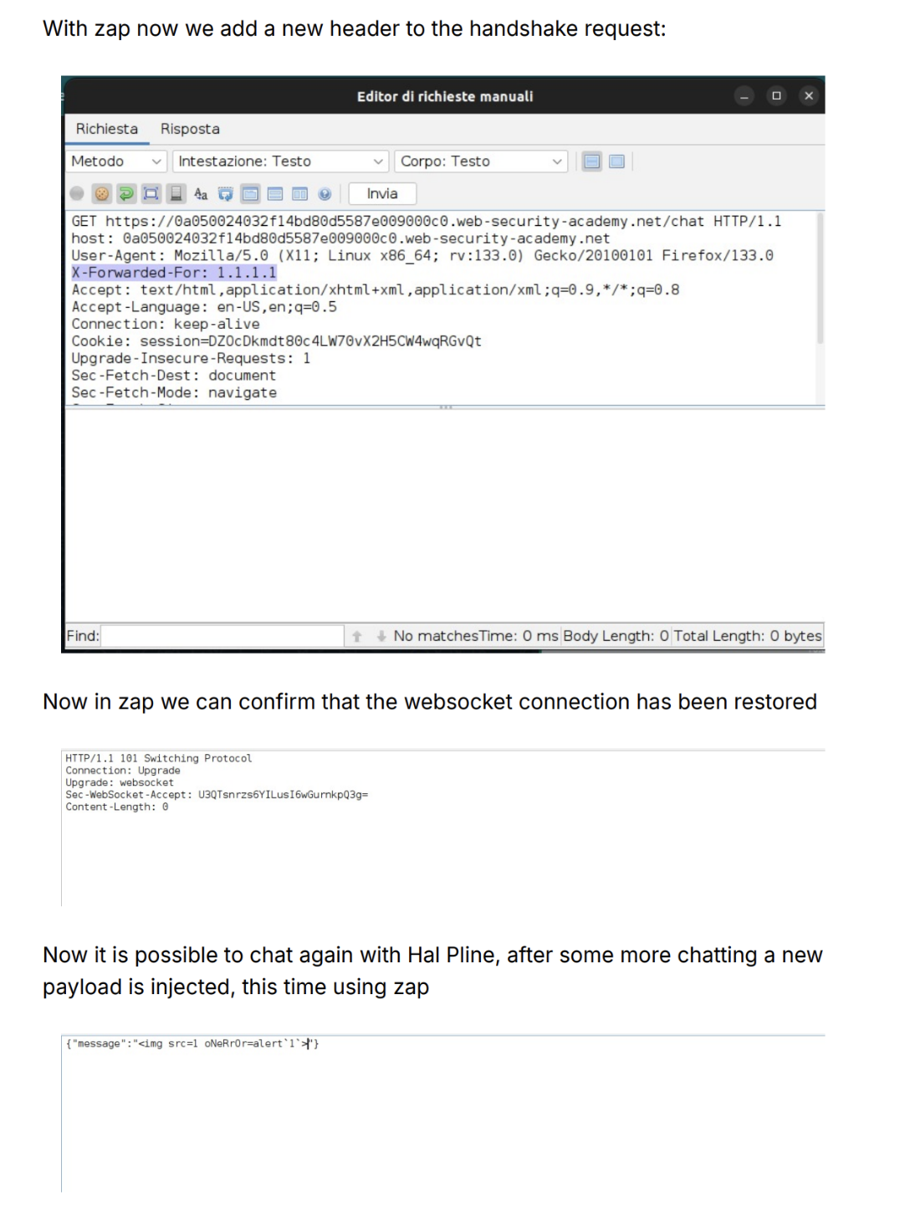

Slide 15
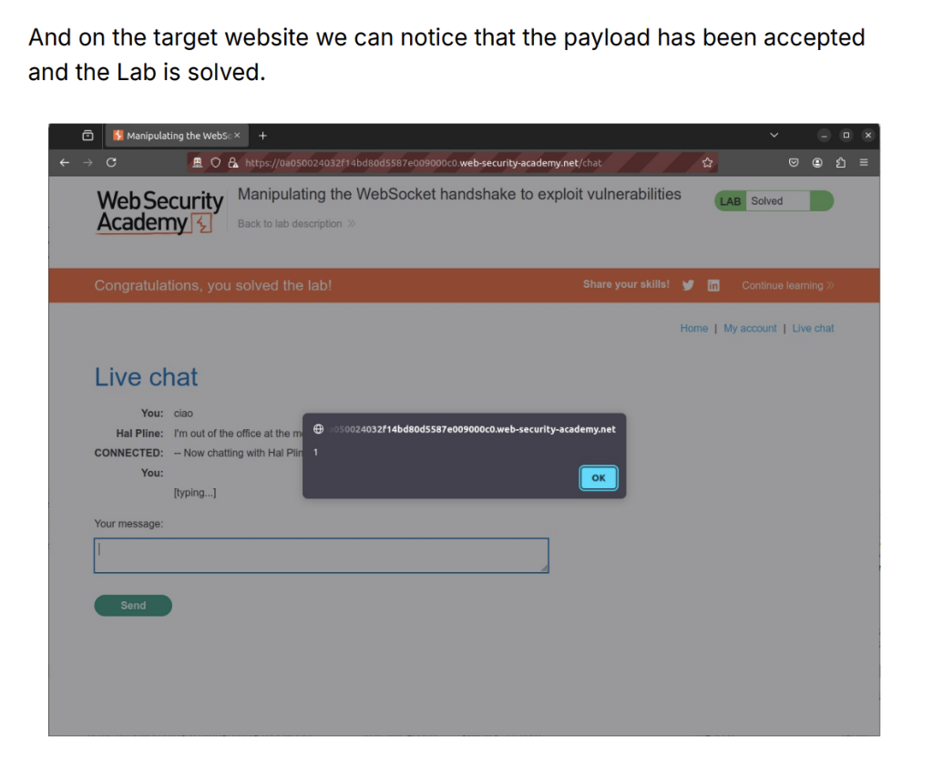

Slide 16
Preventing WebSocket Vulnerabilities
Use WSS:// for secure WebSocket connections. Protect handshake messages against CSRF. Treat data received as untrusted and require user authentication.
Validate client inputs

Slide 17
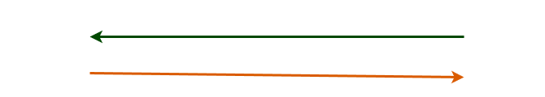
Subscription Model
Another useful prevention technique is a subscription model in which the client does not handle the message directly but keeps a connection with server and gets notified whenever new data is received

Slide 18
Conclusion
WebSocket are a useful tool for a continuous connection. They are not vulnerable by themselves, they just enlarge the attack surface. Knowing how to code safely is the first counter-meausure

Slide 19
7h4nk y0u!

Slide 20


